Slide 1

Keyword Spotting on STM32 L4 board
Ronan Lebas
Machine Learning on Microcontrollers
13. June 2025

Slide 2
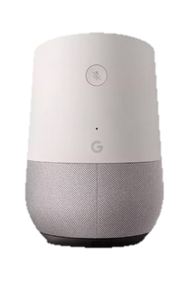

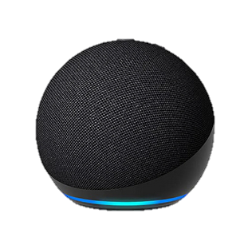

Introduction & Motivation
Keyword spotting: detect and recognize spoken words
Clean, nice way to begin interactions
Always on → reactive, low-power, low-memory
Don’t rely on huge models in the cloud!
Design tiny versions for on-edge computing

Slide 3

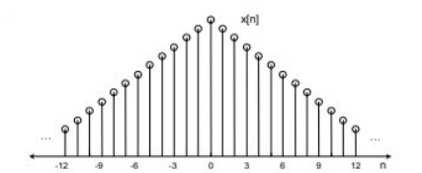
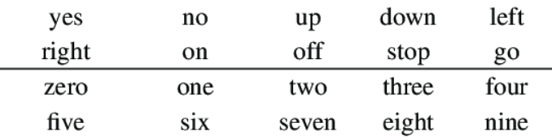
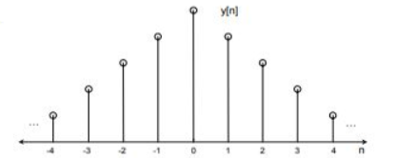
Dataset Selection
Google Speech Commands Data Set v0.02
35 words, ~2100 – 3800 samples of each → Selected 8 words
Original sampling rate of 16 kHz → Down sampled to 8 kHz

Slide 4



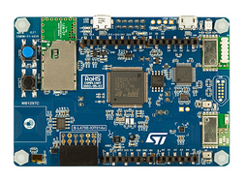
Hardware Platform & Tools
Model design and training → PyTorch
Quantization → ONNX
Deployment → STM CubeIDE / X-Cube-AI
Inference → STM32 L475

Slide 5
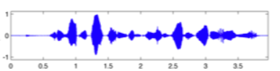
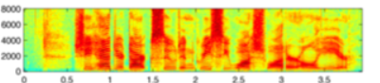
Model & Methodology
Process audio clips with MFCC
Design a CNN for classification
Feature extraction (kernel sizes: conv 3, pooling 2)
Classification
Conv2d + BN
ReLU
Conv2d + BN
ReLU
MaxPool2d / GAP
x2
1x32
32x32
32x64
64x64
Dense
ReLU
Dense
64x32
32x8

Slide 6
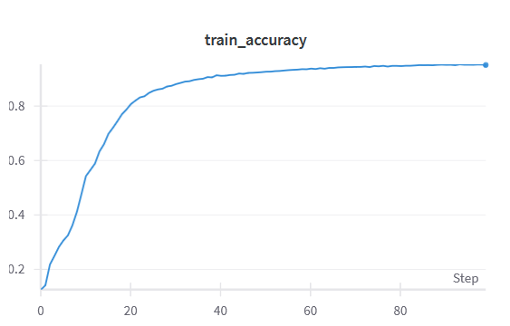
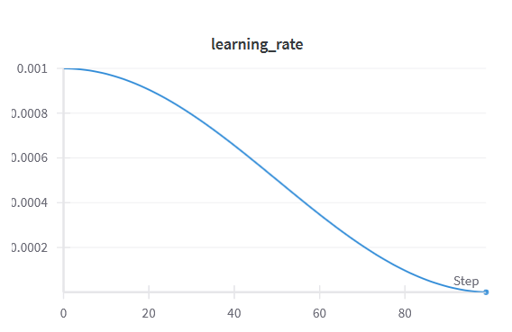
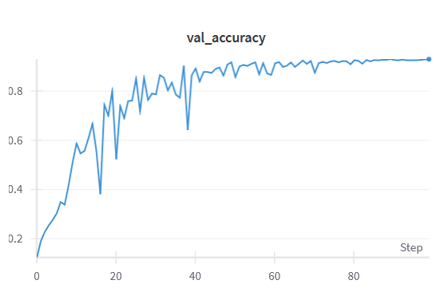
Model & Methodology
Train with SGD + momentum + L2 regularization
Cosine LR scheduler
100 epochs, ~88 min on Tesla V100-PCIE-16GB
Batch size 128

Slide 7
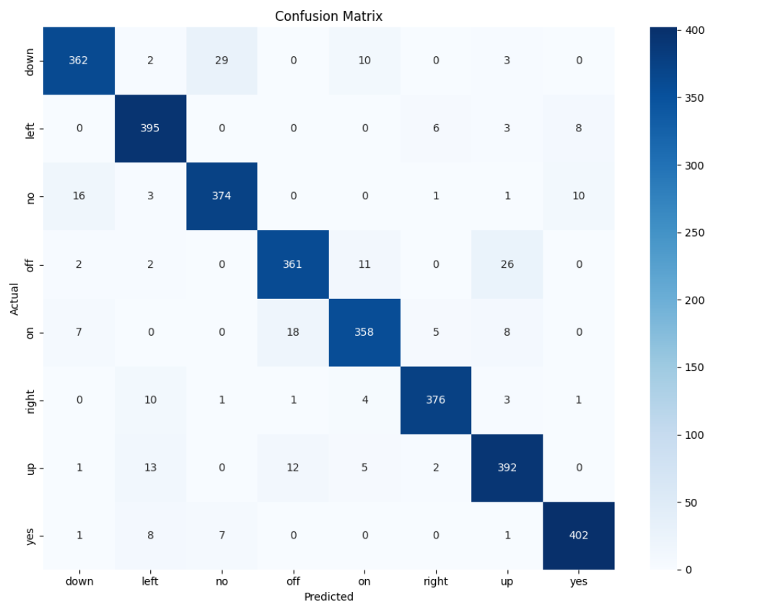
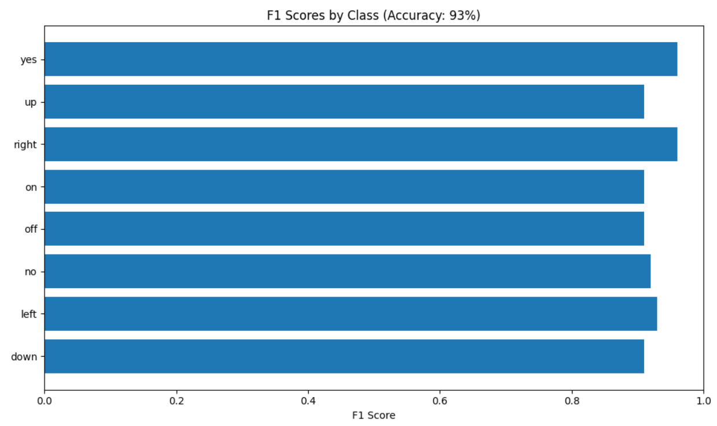
Model & Methodology

Slide 8
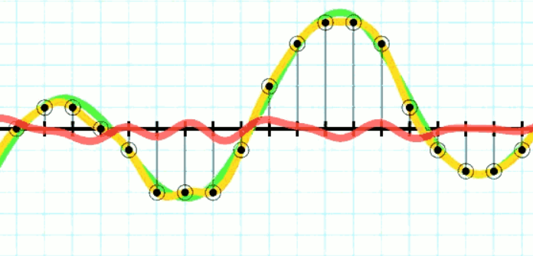
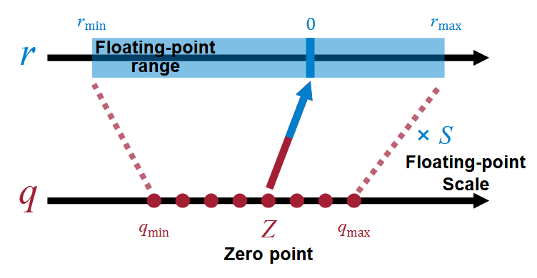
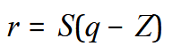
Model & Methodology
Model doesn’t fit on MCU!
Quantization makes model lighter, faster, + efficient
Weights are quantized (8bits)
Activations are quantized (8bits)
Zero-point and scale are computed using a subset of the validation set
Flash: 280.61 KiB → 101.57 KiB (➗2.76) → -65%
RAM: 279.30 KiB → 78.20 KiB (➗3.6) → -72%

Slide 9
Experimental Evaluation
On-device evaluation
Metric | Value
Accuracy | 93%
# Params | 67 336
Latency | ~ 1.3 s/sample
MACC | 47 134 696
CPU cycles | 103 652 729
Cycles / MACC | 2.20
Size in Flash | 102 KiB
Size in RAM | 78 KiB

Slide 10
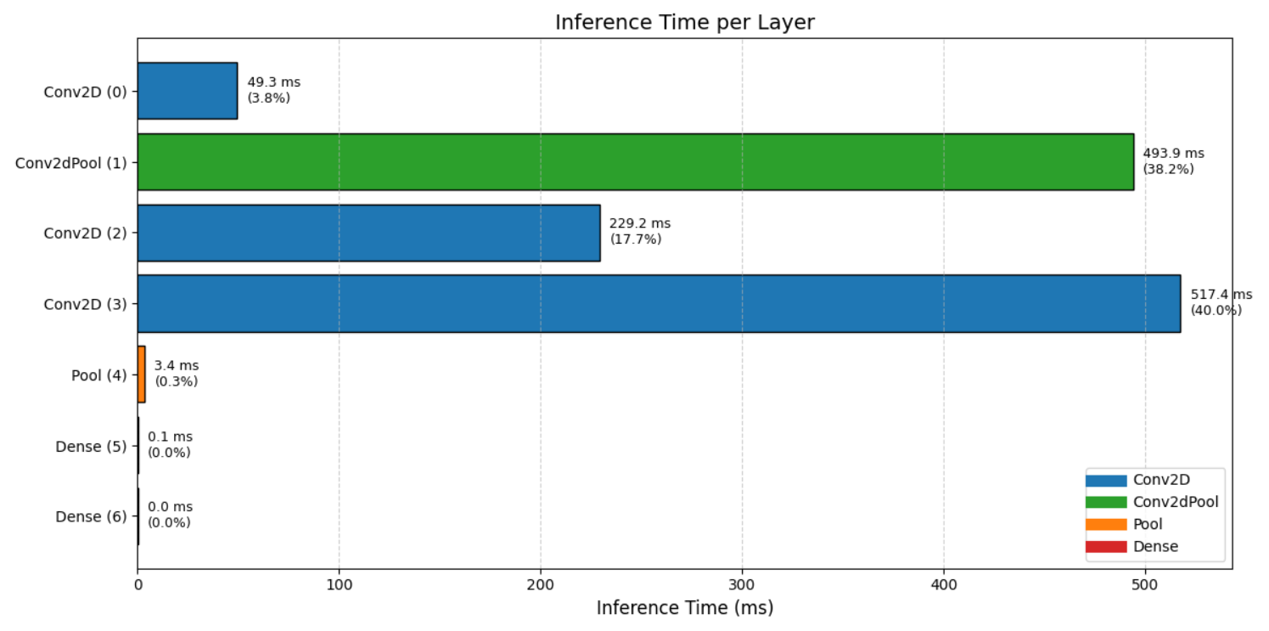
Experimental Evaluation

Slide 11
Comparisons & Trade-offs
Different versions of the model
Metric \ Model | Model 1 | Model 2 | Model 3 | Model 4 | Model 5
Accuracy | 91% (-4) | 70% (-0) | 92% (-2) | 93% (-0) | TOO BIG (94%)
Latency | 2.2 s/sample | 0.3 s/sample | 2.6 s/sample | 1.3 s/sample | TOO BIG
# Params | 295 208 | 19 336 | 592 200 | 67 336 | 1 213 352
Size in Flash | 326 KiB | 53 KiB | 619 KiB | 102 KiB | 1230 KiB
Size in RAM | 79 KiB | 43 KiB | 81 KiB | 78 KiB | 81 KiB
MACC | 73 697 544 | 9 900 136 | 82 550 824 | 47 134 696 | 100 280 712
Cycles / MACC | 2.41 | 2.44 | 2.52 | 2.20 | TOO BIG

Slide 12
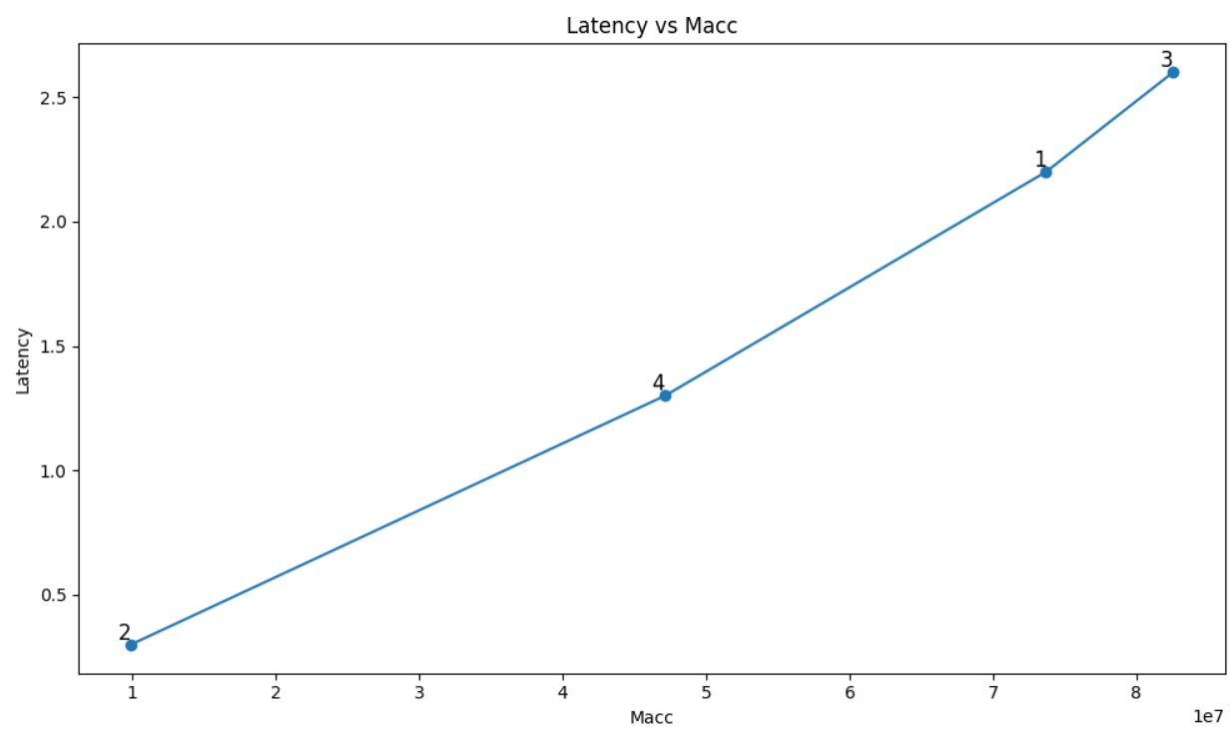
Comparisons & Trade-offs

Slide 13
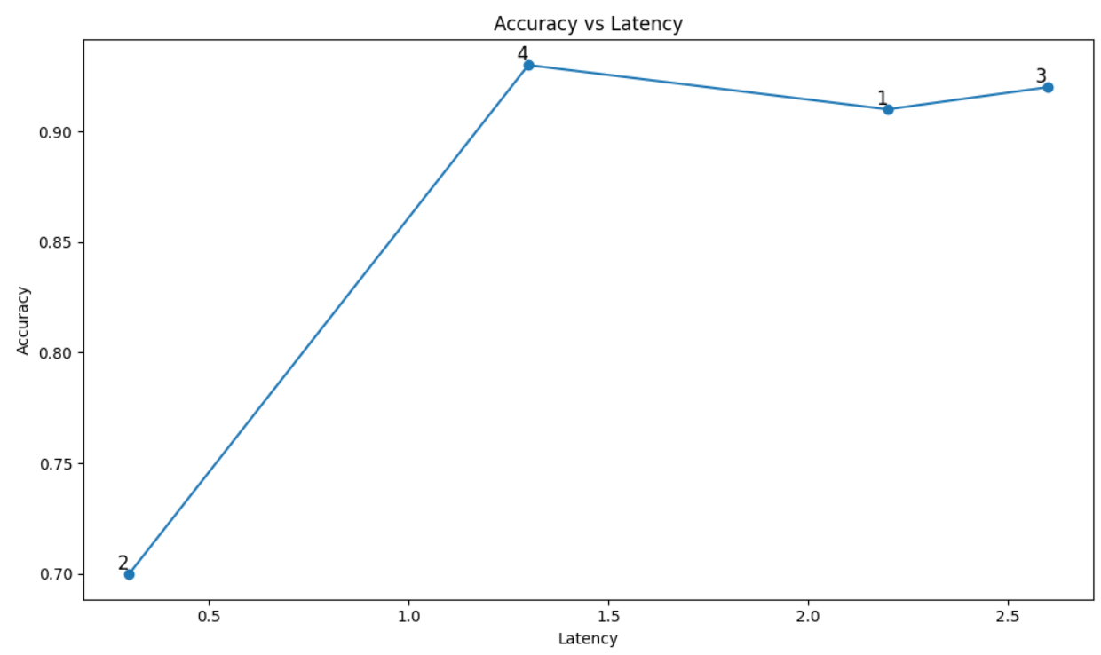
Comparisons & Trade-offs

Slide 14
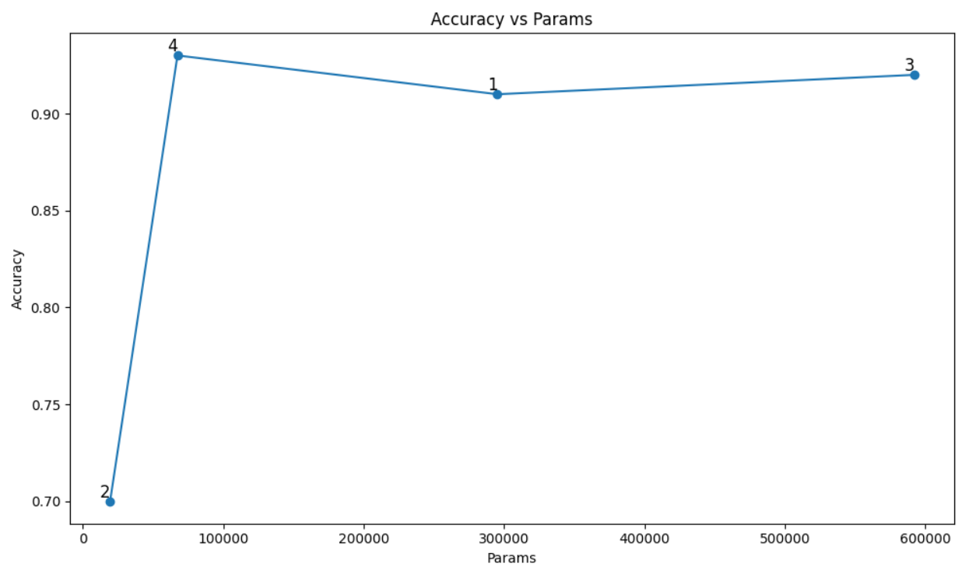
Comparisons & Trade-offs

Slide 15
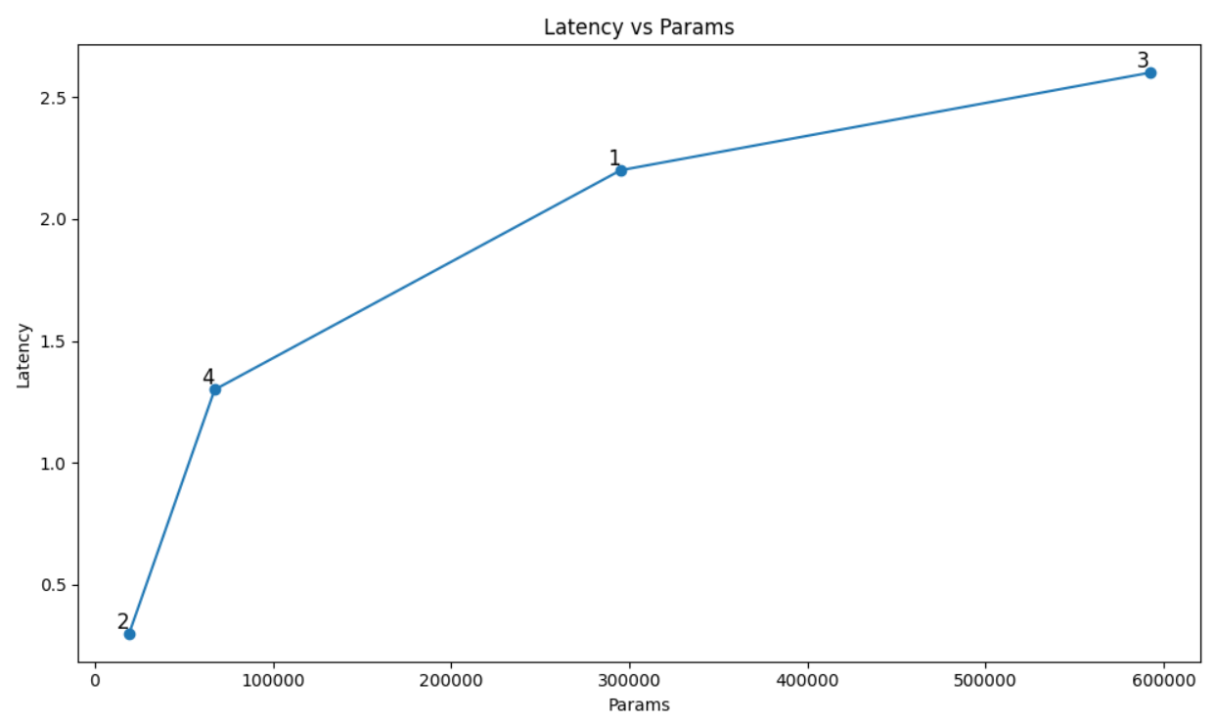
Comparisons & Trade-offs

Slide 16
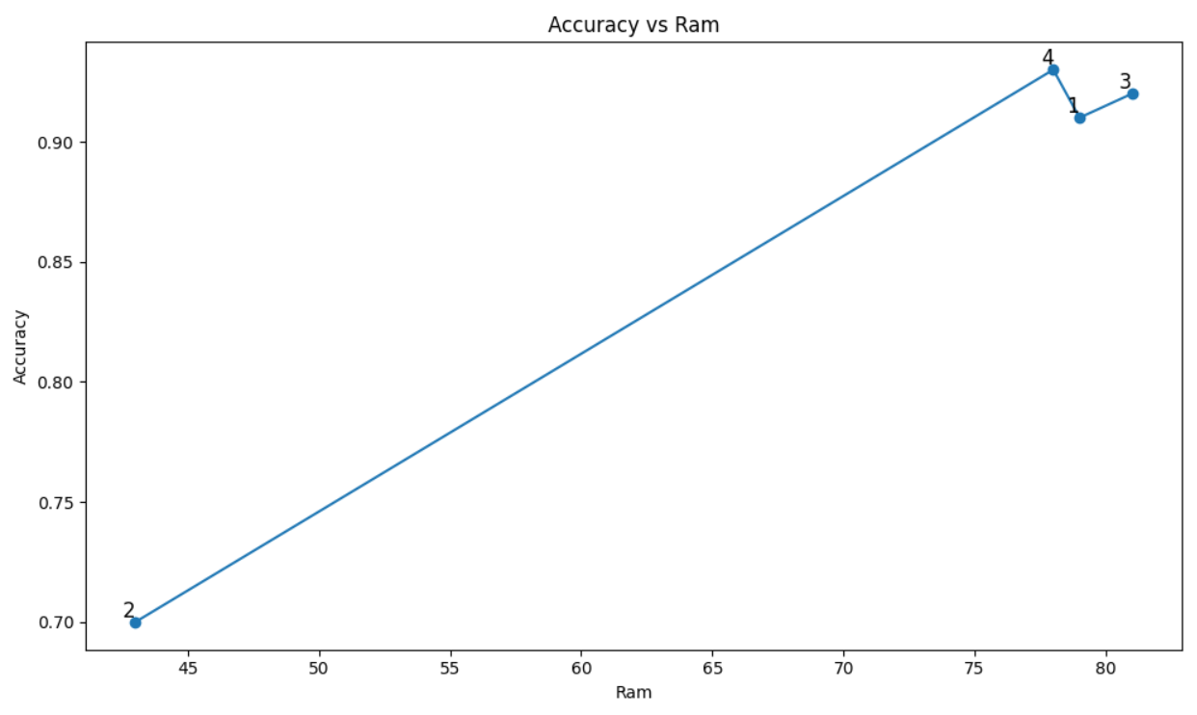
Comparisons & Trade-offs

Slide 17
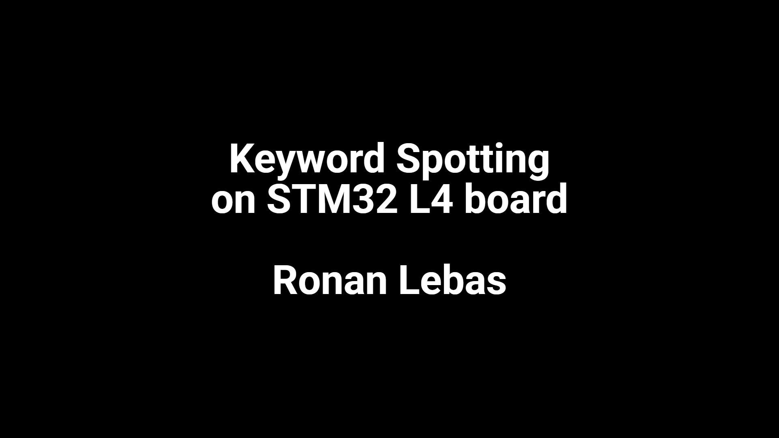
Video Demo

Slide 18
Thank you for listening!

